Slide 1
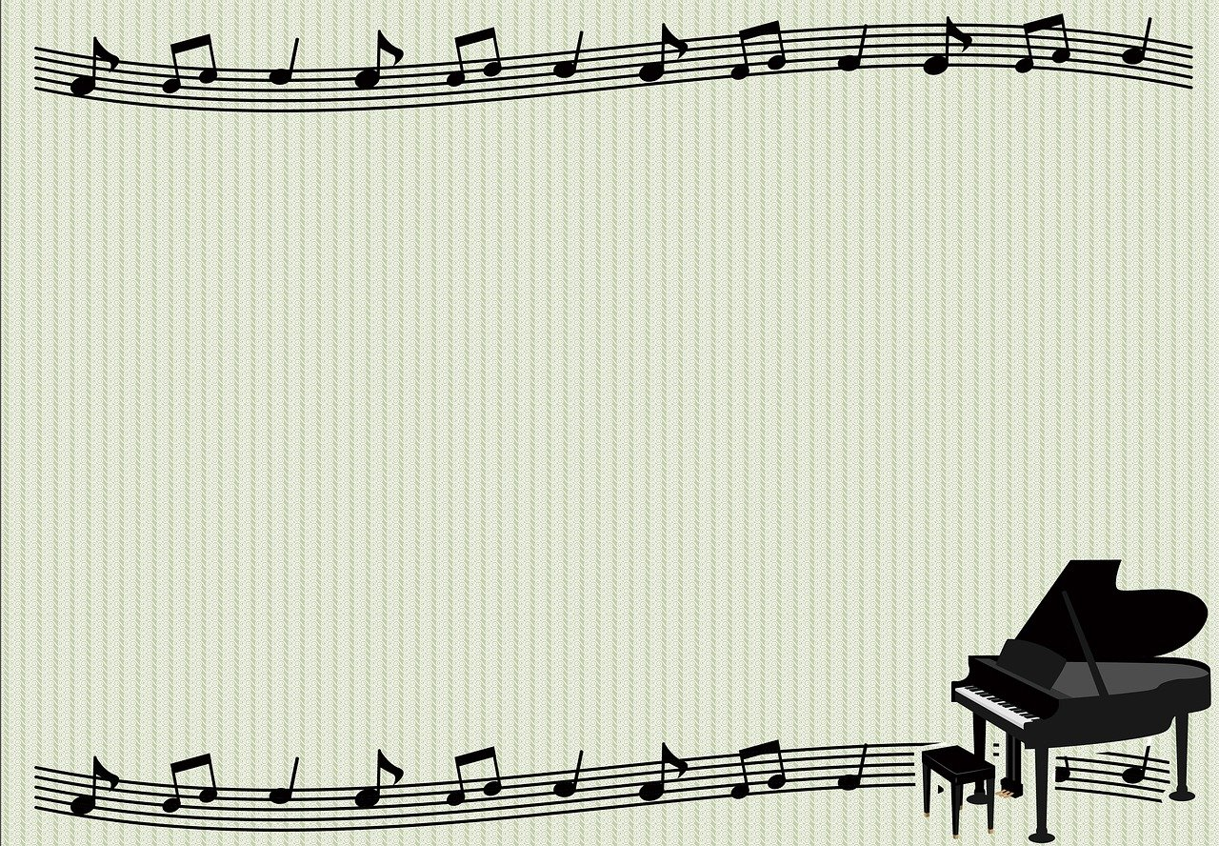
Melodic Improvisation
A story with Franck
Soon Chuan Zhi
Kong Mun Jun
Loi Qi Peng
19WMR03398
20WMR08867
19WMR05253

Slide 2

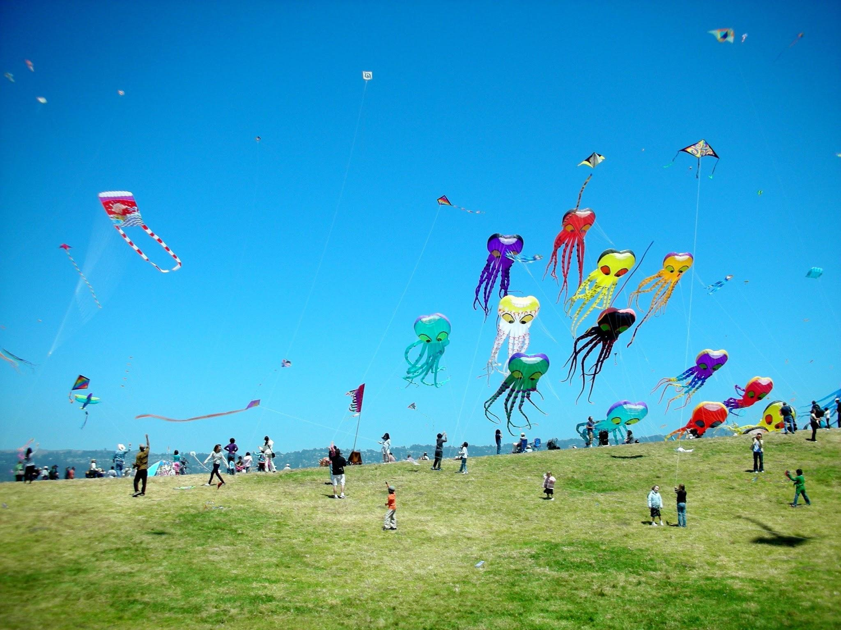
Excited

Slide 3

Hey Franck come out and play ~
It was a beautiful day
all blue and lifting white
When I went into a field with Franck
To fly his favourite kite
Flying kite, chasing game or hide seek
Whatever you wanna play just come with me
Every game I also okay
Do you wanna come and play

Slide 4
It was a beautiful day
all blue and lifting white
When i went into field with franck
To fly his favourite kite
Hey franck
It was a wonderful day
Everyone playing at the park
Just come and fly the kite

Slide 5
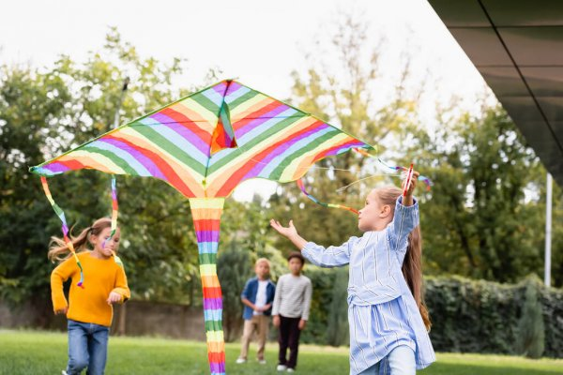
Happy

Slide 6

It was a day...
All blue and lifting white
When I went into a field with Franck,
To fly his kite
We picked up a little kite
In the bigger field
Just watching the kite to fly to the sky

Slide 7
Hey………... ~
It was a wonderful good day ~
Bird Chirping and butterflies flying
Around us everywhere

Slide 8
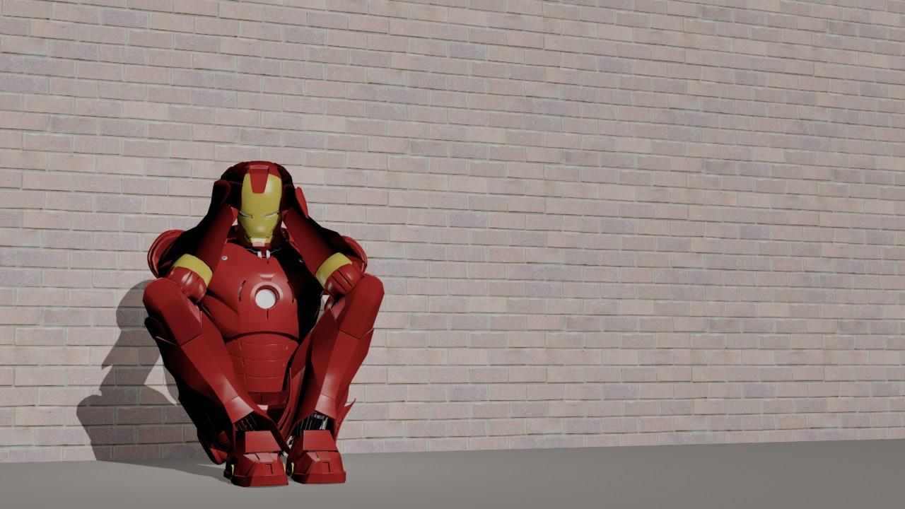
Sad

Slide 9
The sun sun sun come up up up it was a sunny days
The sun sun sun come up up up it was a sunny days
All blue and lifting white
We plan to fly the kite

Slide 10
When I went into a field to play with Franck
We plan to fly the kites
And Franck want to fly his kite
The sun sun sun come up up up it was a sunny day.

Slide 11
The rain rain rain come down down down it was a raining day.
The rain rain rain come down down down it was a raining day.
The rain rain rain come down down down , it was a raining day.
All gray and lifting black

Slide 12
We cannot fly the kite
Then we back to the car and back the home
We cannot fly the kite
And we are sad

